Slide 1




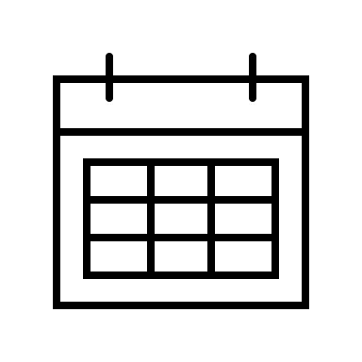
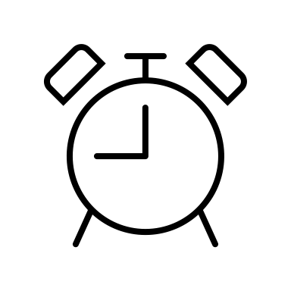


My Day
Search
My Day
Search
New Task
Tasks
New Task
Tasks
+ Add Task
Tasks
e.g. Go grocery # Home
Contents
Tasks
1
1
My Day
1
My Day
1
0
Schedule
Tasks
0
Upcoming
Upcoming
List
List
Add
Cancel
Shopping List
Shopping List
My Day
Search
My Day
Search
New Task
Upcoming
New Task
Tasks
Sun Mon Tues Wed Thurs Fri Sat
e.g. Go grocery # Home
Contents
Tasks
1
Apr 10
Tasks
1
My Day
1
+ Add Task
My Day
1
0
Apr 11
0
Schedule
My Day
Upcoming
Upcoming
+ Add Task
List
List
Add
Cancel
Shopping List
Shopping List

Slide 2
My Day
Search
My Day
Search
New Task
Tasks
New Task
Tasks
Finish project 1
Tasks
1
+ Add Task
Tasks
1
My Day
1
+ Add Task
My Day
1
Finish project 1
0
Undo
0
Upcoming
Upcoming
List
List
Shopping List
Shopping List

